Slide 1


Movie Production Analysis & Prediction
Project
Presentation Slides
ID: 320210207
Name: Yousef Ibrahim Gomaa Mahmoud
P. <number>

Slide 2
Introduction
Problem Introduction:
  In this notebook, we explore various aspects of movie production and promotion, aiming to uncover patterns and insights that can contribute to the success of a film.
  The task is to analyze this dataset and build a predictive model that can help stakeholders make informed decisions about movie production and marketing strategies.
P. <number>

Slide 3
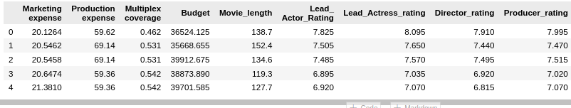
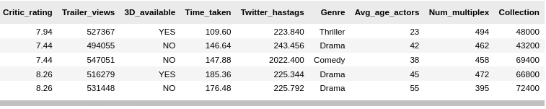
Dataset
Data Description:
  The goal is to perform classification and regression on “Collection.” The dataset is found to have key parameters, such as:
P. <number>

Slide 4
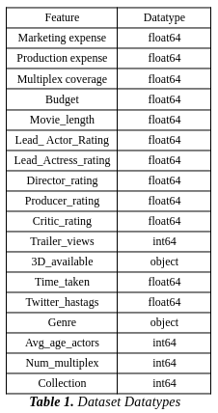
Dataset
P. <number>

Slide 5
Preprocessing
Data Preprocessing:
  The data is filtered for missing values and/or duplicates, approaches such as dropping or filling with mean/mode/median are viable options.
  Conclusion
    Data types are correctly casted.
    Missing values found in the data given, which are in turn replaced with mean values since it is float64 type.
    No duplicated records.
P. <number>

Slide 6
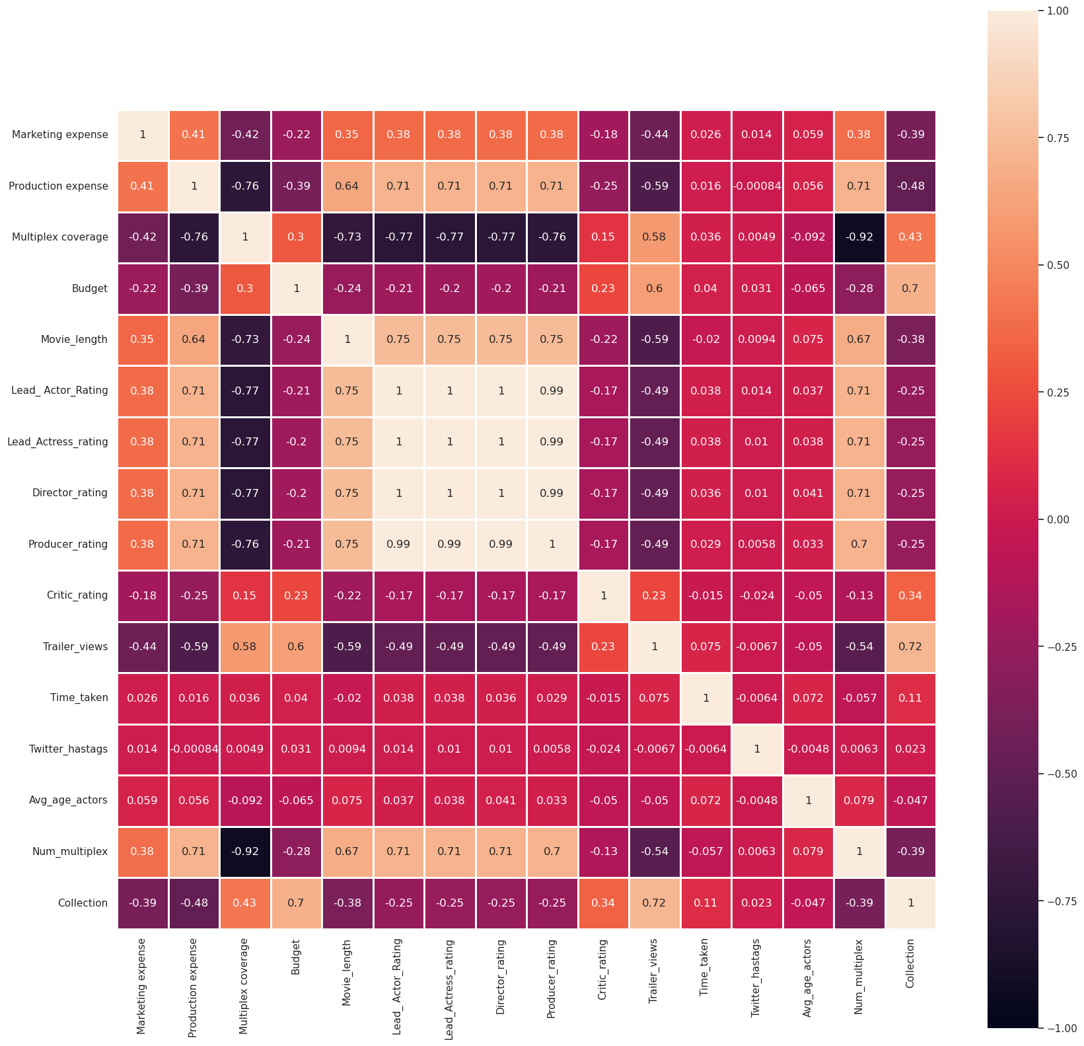
Preprocessing
Data Preprocessing:
  A correlation matrix is done to evaluate the dependencies and correlation between the features.
P. <number>

Slide 7
Preprocessing
Data Preprocessing:
  Afterwards, we use Z-Test and ANOVA (Analysis of Variance), which are statistical tests used in different scenarios, to make inferences about population parameters or to compare means across different groups.
  Results:
    Z-test: Failed to Reject the Null Hypothesis
    ANOVA: Reject the Null Hypothesis
P. <number>

Slide 8
Machine Learning
Machine Learning Techniques:
  Some machine learning techniques are evaluated.
  K-NN (All kinds)
  LDA
  Naive Bayes
  Decision Tree
  Neural Networks
P. <number>

Slide 9
Machine Learning
K-NN:
  Results: (Accuracies & Mean Absolute Error are shown here, other evaluation metrics in the documentation) (K=2 & K=7 respectively)
    K-NN with PCA: 79.41176470588235%
    K-NN with LDA: 85.29411764705883%
    K-NN with SVD: 77.45098039215686%
    K-NN Regressor (different distances)
      Euclidean Distance: 6898.0392156862745
      Manhattan Distance: 7085.994397759105
      Cosine Distance: 7223.529411764704
P. <number>

Slide 10
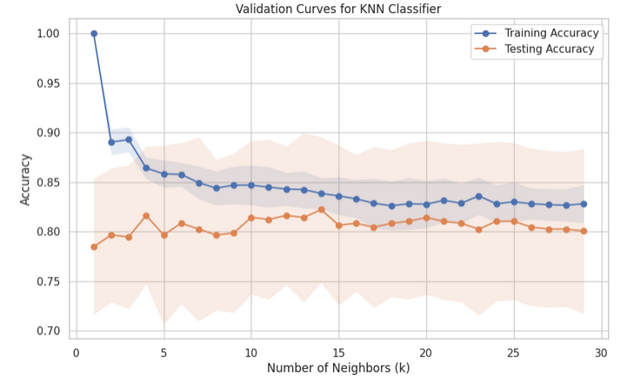
Machine Learning
K-NN:
  Different K values
  Highest yield at 2
  Stagnates at 0.55
P. <number>
0.6568627450980392
0.6568627450980392

Slide 11
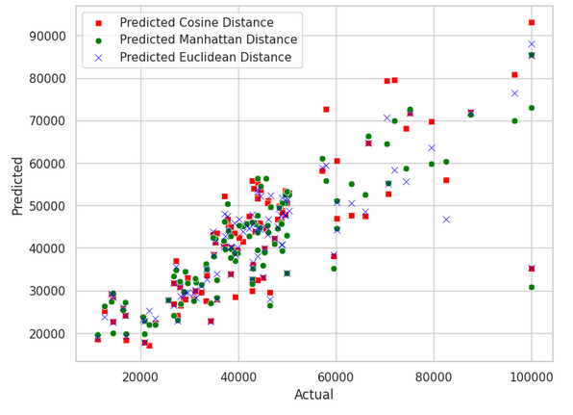
Machine Learning
K-NN Regressor:
P. <number>

Slide 12
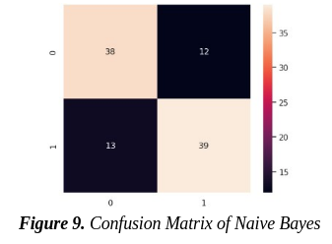
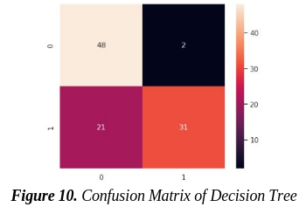
Machine Learning
Naive Bayes:
  Results: 0.7549019607843137
Decision Tree:
  Results: 0.7745098039215687
P. <number>

Slide 13
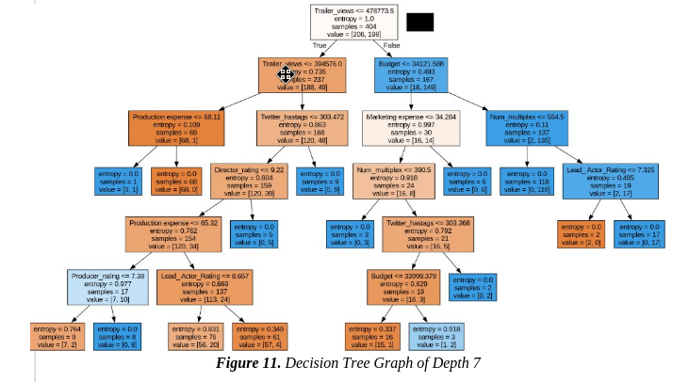
Machine Learning
Decision Tree:
  Depth 7
P. <number>

Slide 14
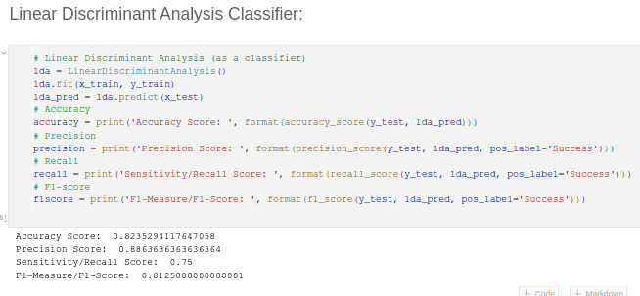
Machine Learning
Linear Discriminant Analysis:
P. <number>

Slide 15
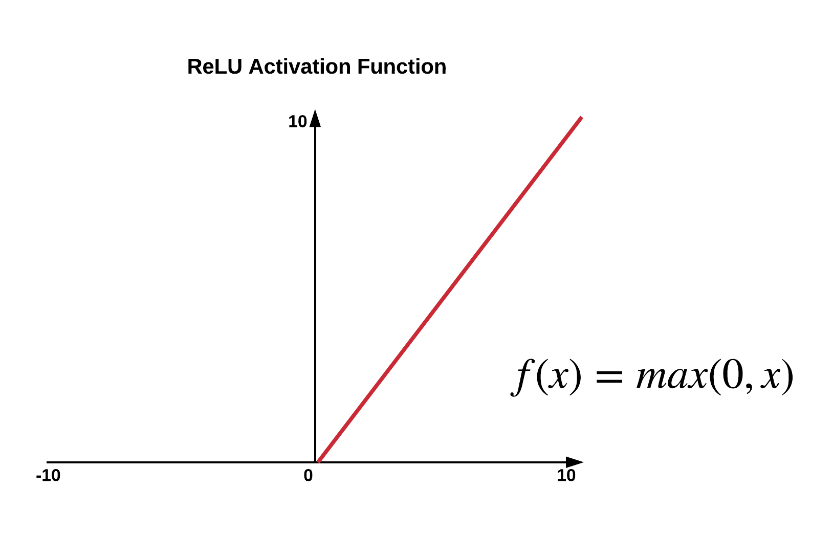
Machine Learning
Neural Networks:
  4 Dense Layers:
    1024 filters, “RELU” activation function.
    512 and then 256 filters, “RELU” activation function.
    Output layer, “Sigmoid” activation function.
    Optimizer: ADAM
    Results: 0.8529411554336548
P. <number>

Slide 16
Conclusion
Conclusion:
  The study suggests that predicting gross revenue during production is not very accurate. The developed models are imperfect, as they do not consider various variables like plot, social media sentiment, stardom, and awards. The use of more advanced techniques, may improve revenue predictions in the future.
  Best model to be used:
Neural Networks → 0.8529411554336548
P. <number>

Slide 17
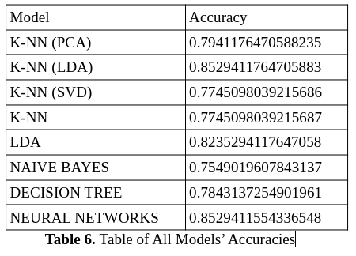
Conclusion
P. <number>

Slide 18
Movie Production Analysis & Prediction
Thank you.
P. <number>

